Slide 1

IEM CONNECTOR
A Centralized Campus Collaboration Platform
Streamlining student life at IEM Campus through unified event discovery, team formation, and resource sharing
Team: BlackWolf
Team Members: Pratham Gupta, Shoyaib Rahaman, Anomitro Saha, Rupak Sil Institution: Institute of Engineering and Management.

Slide 2

The Problem: Fragmented Campus Life
Students face information overload across disconnected platforms, wasting valuable time searching for opportunities and struggling to find the right resources.
Information Overload
Event information scattered across WhatsApp groups, email inboxes, and physical notice boards
Disconnected Platforms
No unified system for team formation, resource sharing, or discovering campus events
Team Formation Barriers
Difficulty finding skilled teammates for competitions and projects
Resource Scarcity
No central place to share study materials, notes, or academic resources

Slide 3



Our Solution: One Platform for Everything
IEM Help brings campus collaboration into one unified space, making it effortless for students to discover opportunities, build teams, and share resources.
Discover Events
Build Teams
Share & Trade
Find all campus events, competitions, and workshops in one centralized feed
Connect with like-minded students and form teams for competitions
Access resources and participate in the campus marketplace

Slide 4






Key Features
Secure Authentication
Event Discovery & Registration
College email verification ensures a trusted, secure platform for all students
Browse upcoming events, competitions, and workshops with one-click registration
Team Builder for Competitions
Event Leaderboards
Post team requirements, find skilled members, and collaborate effectively
Track competition rankings and celebrate top performers across campus
Resource Sharing Hub
Campus Marketplace
Upload and download study materials, notes, and academic resources
Buy, sell, and trade textbooks, equipment, and other student essentials

Slide 5




System Architecture
A robust three-tier architecture ensures scalability, security, and fast response times for all platform operations.
Frontend Layer
HTML, CSS, and JavaScript create an intuitive, responsive user interface that works seamlessly across all devices
Backend API
Node.js powers server-side logic, handling requests, authentication, and business operations efficiently
Database
MySQL stores user data, events, teams, and marketplace listings securely and reliably

Slide 6
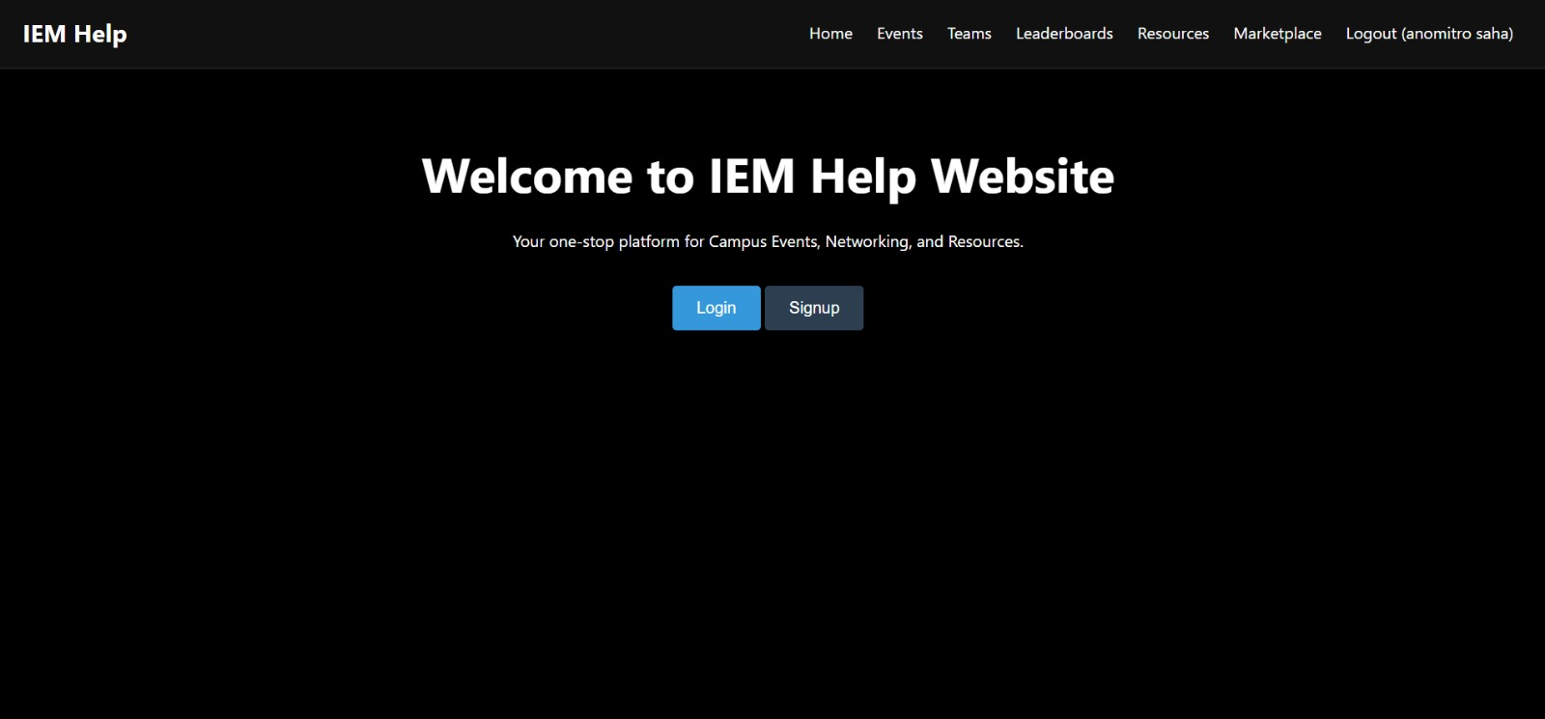
Platform Demo
Login Page

Slide 7
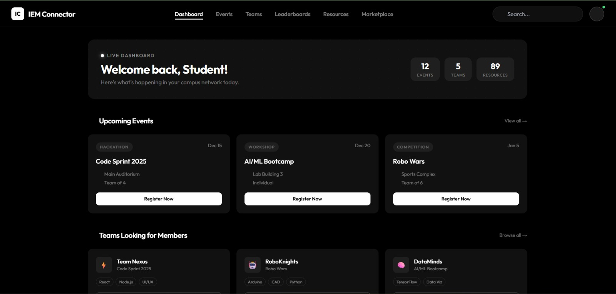
Platform Demo
Welcome Dashboard

Slide 8
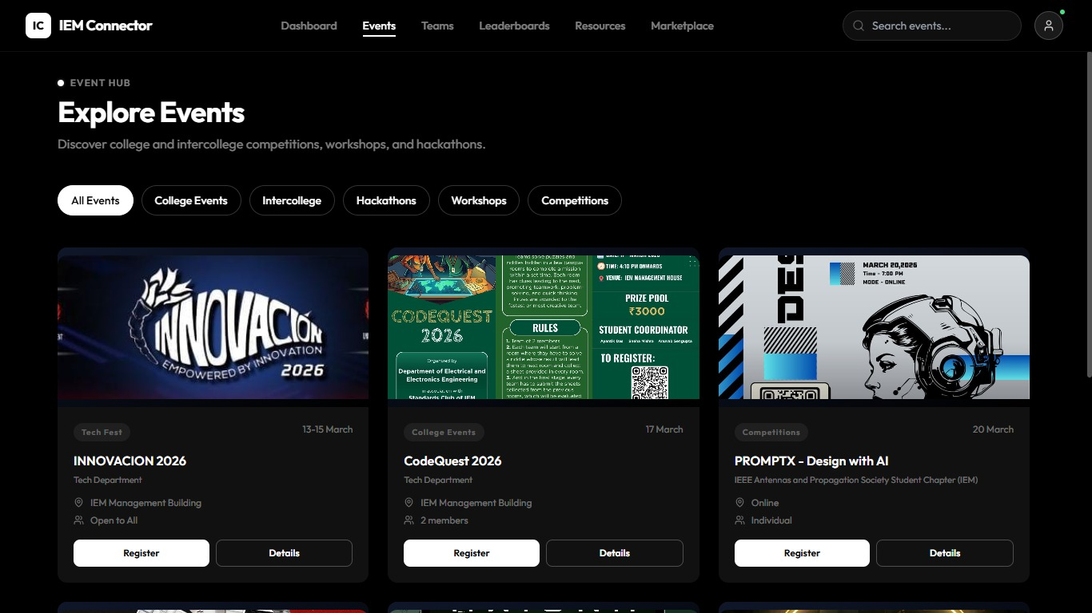
Platform Demo
Event Page

Slide 9
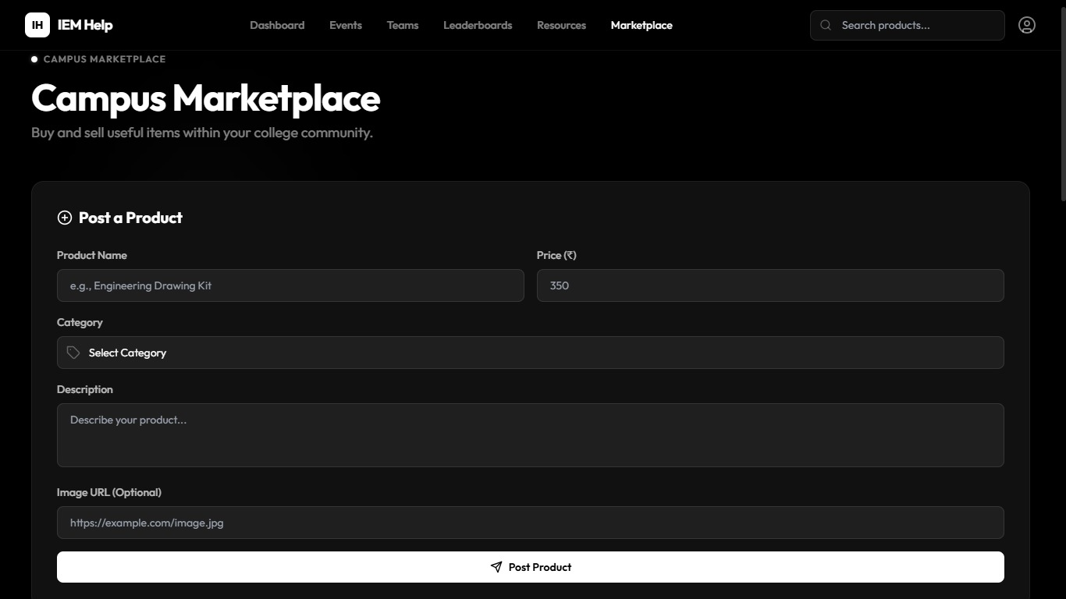
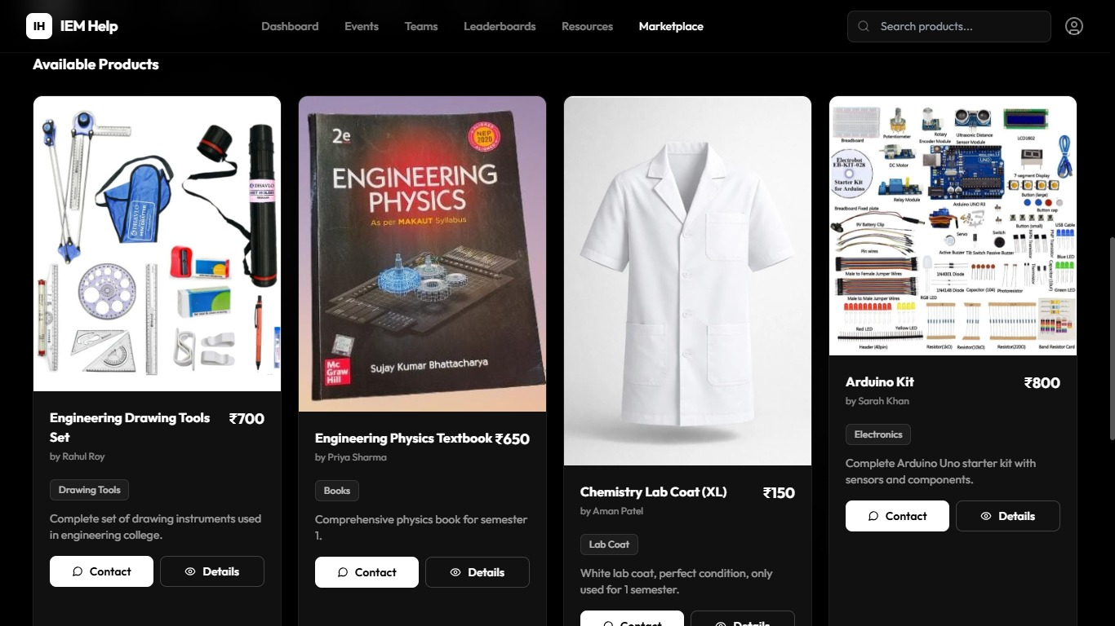
Platform Demo
Market Place Page

Slide 10





Impact & Benefits
Centralized Event Management
One platform for all campus activities eliminates information fragmentation
Enhanced Collaboration
Students connect, form teams, and work together more effectively
Increased Participation
Easy discovery and registration boost competition and event attendance
Resource Accessibility
Academic materials and study resources become easily accessible to all

Slide 11
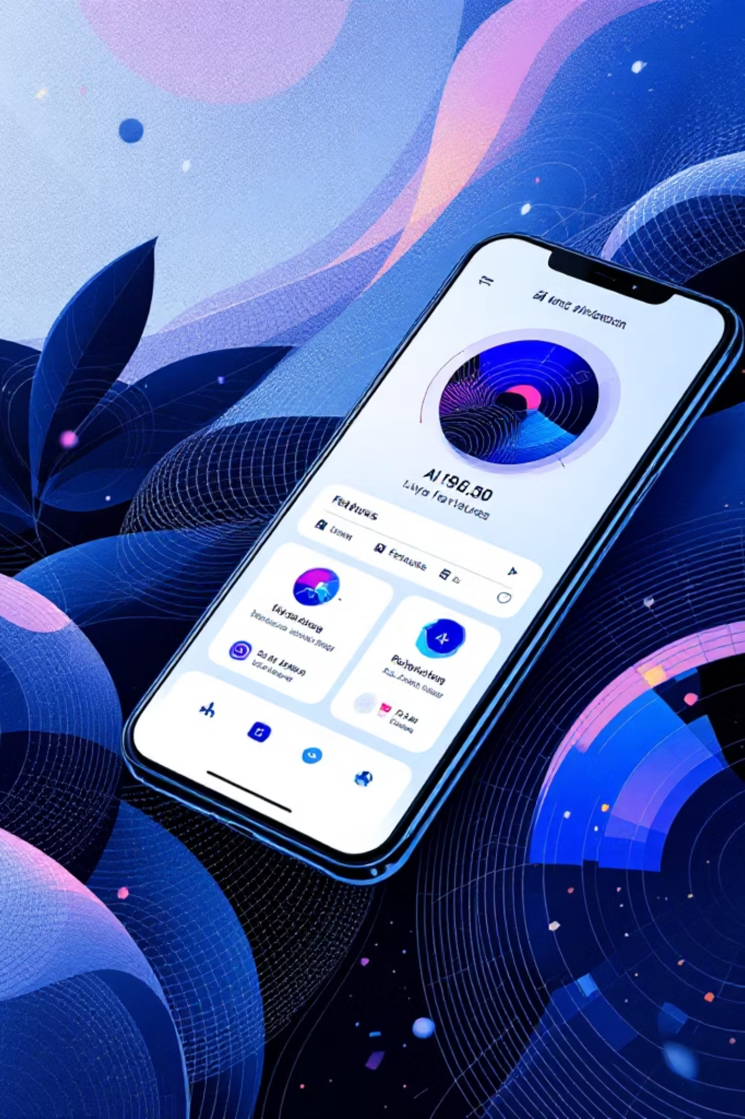



Future Scope: Growing Beyond Today
Expanding IEM Help's capabilities to provide even more value to students through mobile access, intelligent matching, and career development.
Mobile App
Native iOS and Android applications for on-the-go access to all platform features
AI Matching
Smart algorithms recommend events and team members based on interests and skills
Career Hub
Internship and job opportunities connecting students with employers and alumni

Slide 12
Technology Stack
Frontend
Database
HTML5 for structure
CSS3 for styling
JavaScript for interactivity
MySQL for data storage
Secure data management
Fast query processing
Backend
Authentication
Node.js runtime
Express framework
RESTful APIs
College email verification
Secure login system
Data protection

Slide 13
Thank You
Team BlackWolf
Pratham Gupta • Shoyaib Rahaman • Anomitro Saha• Rupak Sil
Project: IEM Connector – Campus Networking Platform

